Slide 1

Lung CT image segmentation
using deep neural networks

Slide 2
01
02
PROBLEM
PROCESS
03
04
APPLICATION
PROJECT PLANNING

Slide 3

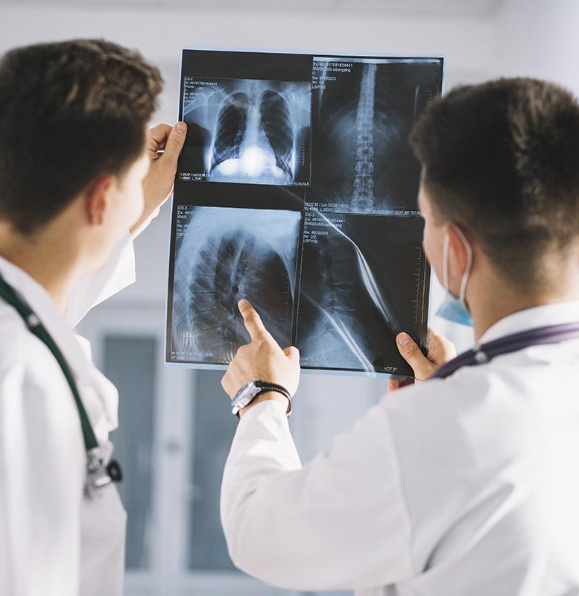
01
Overview
Lung diseases: the leading causes of death in developing countries.
Chest X-ray (CXR): the most effective way to diagnosis many kind of lung diseases
-> Lung CT image segmentation
using deep neural network
Notes:
Chest X-ray (CXR) is the most common biomedical imaging
Effective interpretation of CXR requires years of experience, time consuming

Slide 4
02
Process
01
02
03
PROBLEM
DATA
MODELING
Define the problem statement
Define input, output
Data collection
Data preprocessing
Build DL Model
Lung CT image segmentation
Performance Evaluation

Slide 5
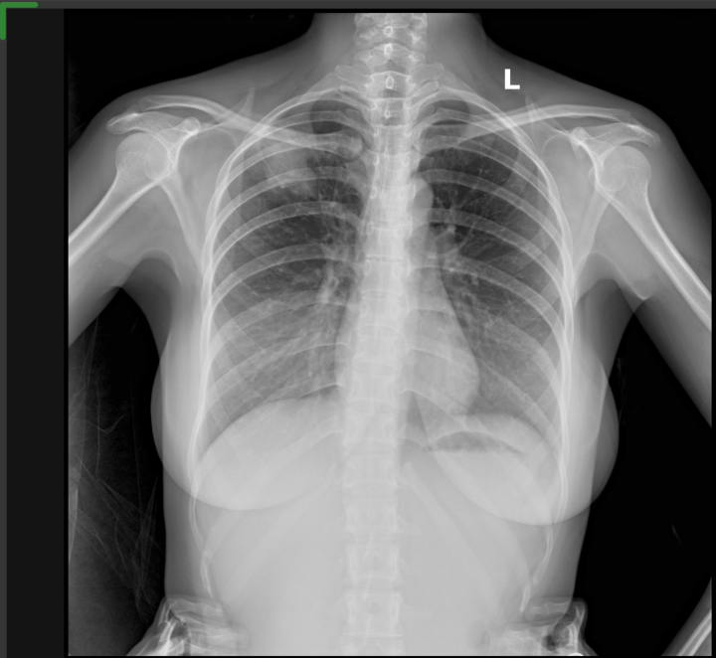
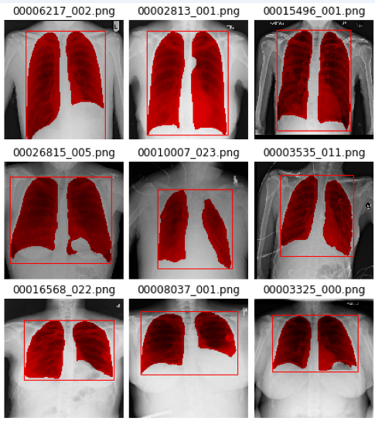
INPUT
OUTPUT
X-ray images in PNG 3074x3074 format
Lung CT images Segmentation

Slide 6
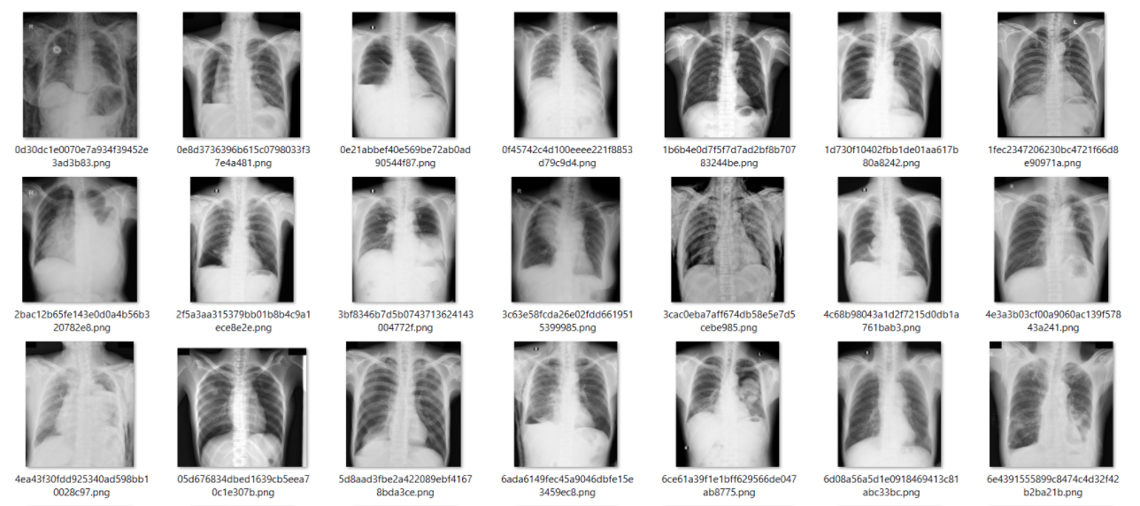
Dataset
The Department of Health and Human Services of Montgomery County, MD, USA.
138 posterior-anterior x-rays:
80 x-rays are normal
58 x-rays are abnormal with manifestations of tuberculosis
50%
15%
Notes:
Source: www.kaggle.com/c/vinbigdata-chest-xray-abnormalities-detection/data
Lọc hình ảnh từ bệnh Pneumothorax và chuyển đổi sang PNG
Inflammatory condition of the lung cause by bacterial, fungi, etc.

Slide 7
03
Application
1
2
Classifying common thoracic lung diseases
Breast cancer diagnosis on X-ray
Diagnosis of liver cancer on CT images
Diagnosis of brain tumors on resonance imaging (MRI)
3
4

Slide 8
04
PROJECT PLANNING
Data Collection
Preprocessing
Lung segmentation
Classification
Evaluation
Get and explore data
Preprocess data
Build Unet Model
Build RestNet model
IoU
Dice coefficient
H. Phuc
Q. Cuong
H. Phuc
Nhan
Q. Anh
Q. Cuong
B. Sam
Q. Cuong
B. Sam
H. Phuc
Q. Anh
B. Sam
Nhan

Slide 9

Thanks!

